Slide 1
SEMI AUTOMATIC VOICE CONTROLLED AND
MOBILE CONTROLLED VEHICLE
SANTHOSH.N (13BIC030)
LOGESHWARAN.M (13BIC022)
ARAVINDAN.B (13BIC023)
PRASANNA KUMAR.R (13BIC012)
PROJECT GUIDE
GANESHAN.M

Slide 2
OBJECTIVE
To develop a motor vehicle for physically challenged people & modern revolution in automobile world.

Slide 3
INTRODUCTION
Our car is designed with a view of development in modern technology as remedy for physically challenged people.
The car is designed with three technologies.They are as follows,
Semi automatic.
Voice recognition.
Mobile controlled.
It is provided with two sensor which makes our car an automated vehicle.
The heart of our vehicle is embedded system {Arduino UNO(ATMEGA 328)}.

Slide 4
EXISTING MODEL
The autonomous vehicle were first introduction by Mercedes Benz.
The deficiency in this vehicle is that the vehicle can only be operated automatically and can not be controlled by other means.
Many companies after that were trying to develop autonomous cars and still they are in progress.
Tata motors ,India is a company which is developing the automated cars in our country.

Slide 5
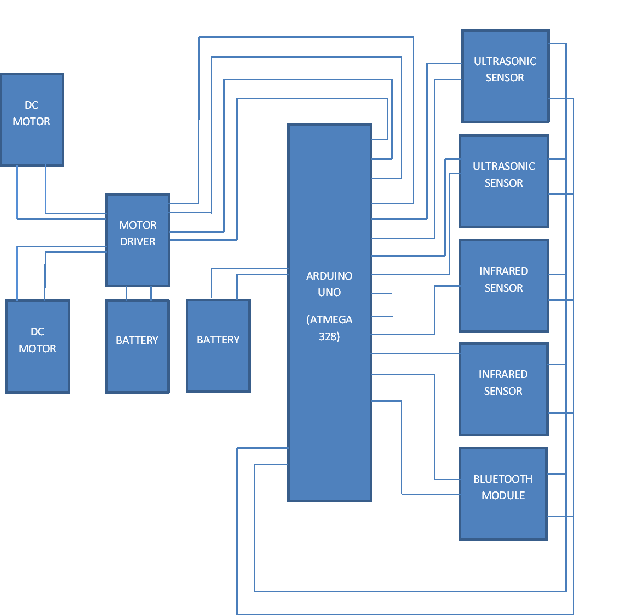
Block diagram

Slide 6
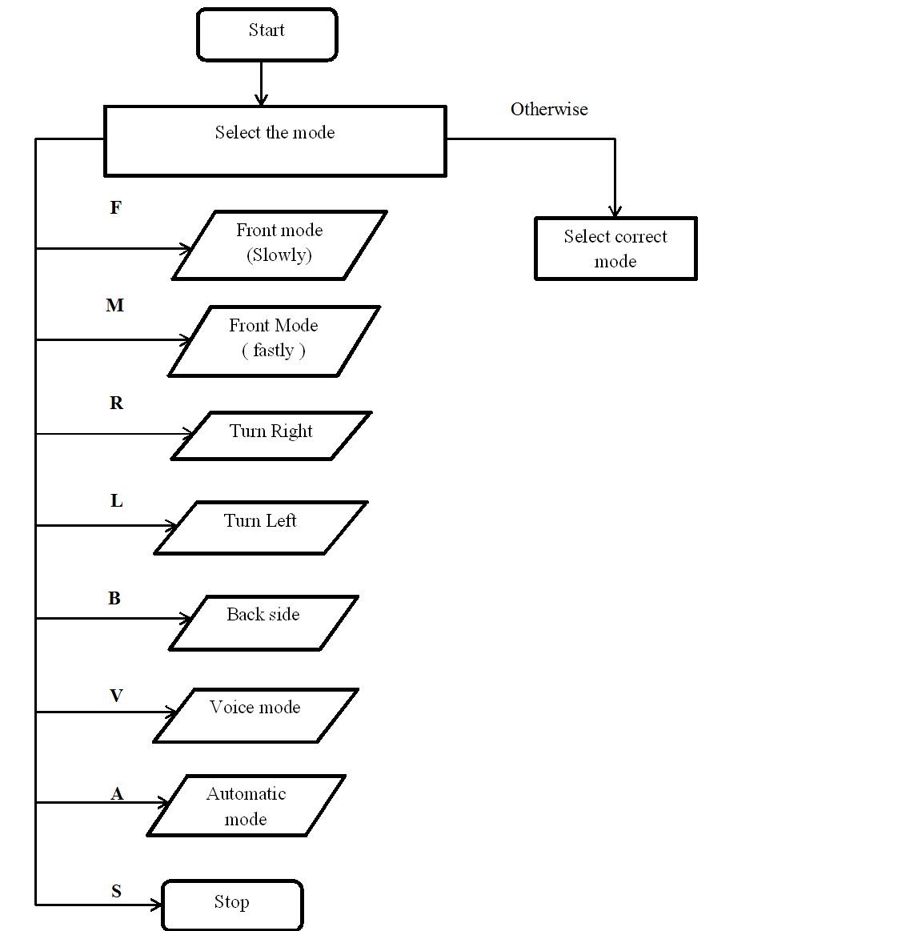
Flow chart

Slide 7
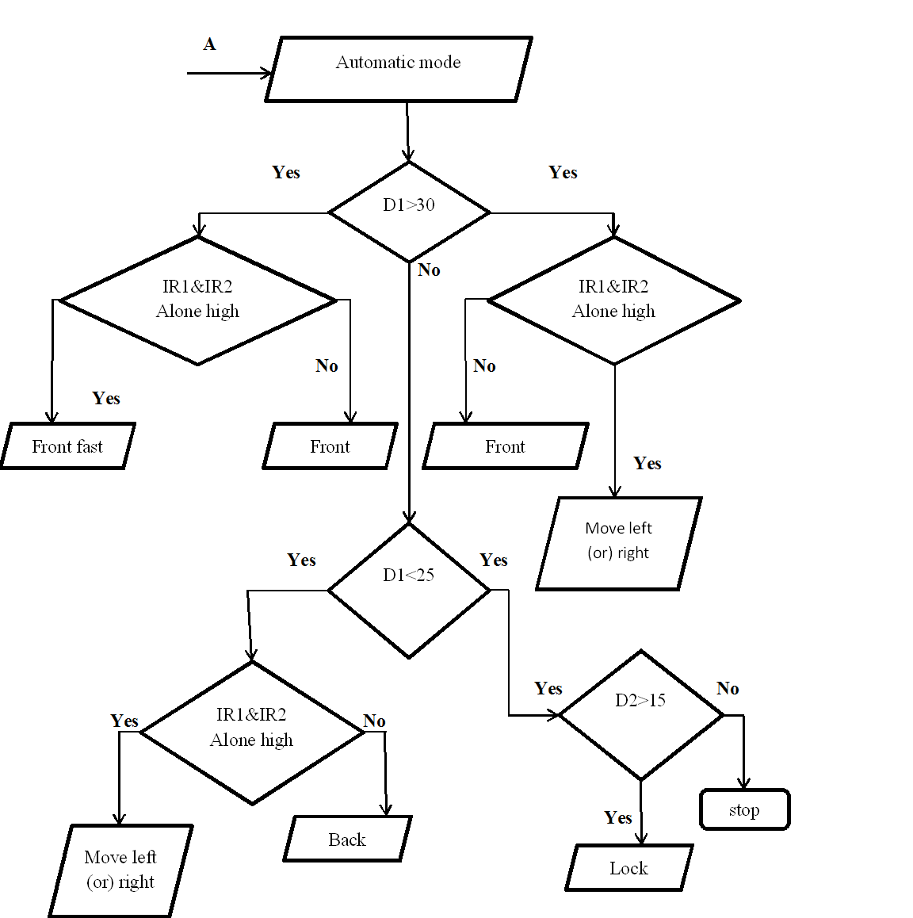
CONTD….

Slide 8
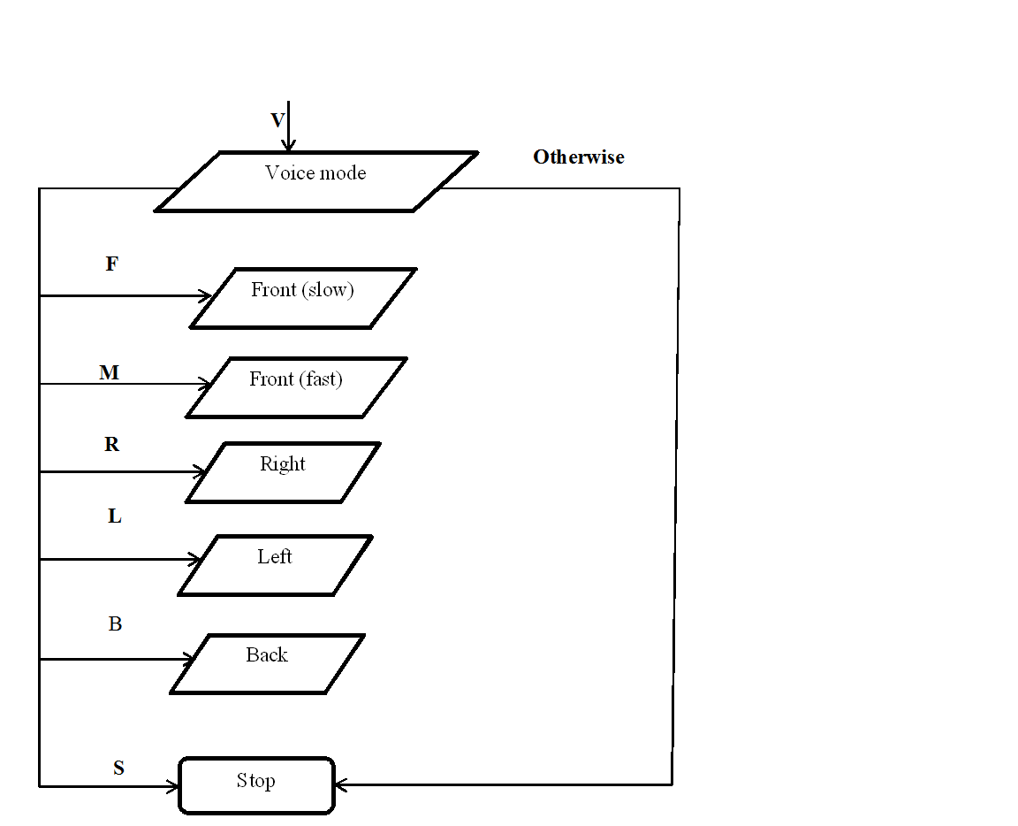
CONTD….

Slide 9
COMPONENTS FOR THE PROJECT
Arduino Uno board
Ultrasonic sensors (2)
DC motor (2)
Motor driver (2)
IR sensor (2)
Bluetooth module
Chassis
Battery
Mobile phone
Connecting wires

Slide 10
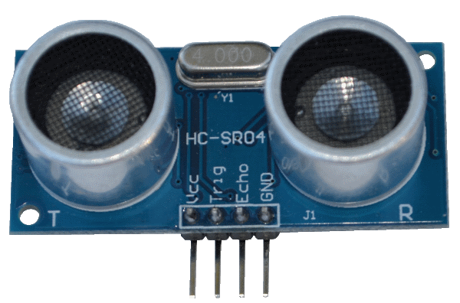
ULTRASONIC SENSORS
Detecting Range is about 3cm to 4.5m.
Detection Angle :30 degree
Power supply :5v dc supply
Ultrasonic frequency :40 kHz
Trigger pulse width :10 µs
Global current consumption :15 mA

Slide 11
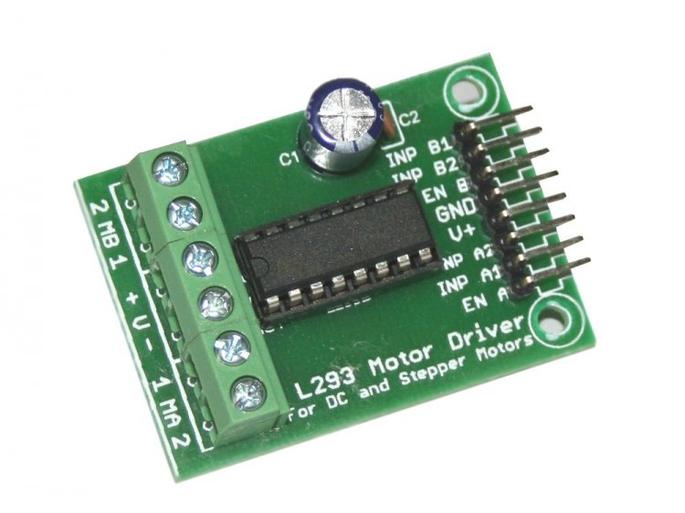
MOTOR DRIVER(L293D)
Voltage range :4.5v to 36v
Current :100 mA to drive motor
Max resistance :60 Ώs
o/p current capability :600 mA
Pulsed current :1.2 mA per drive.
Package :16 pin DIP
Ic weight :2 gram

Slide 12
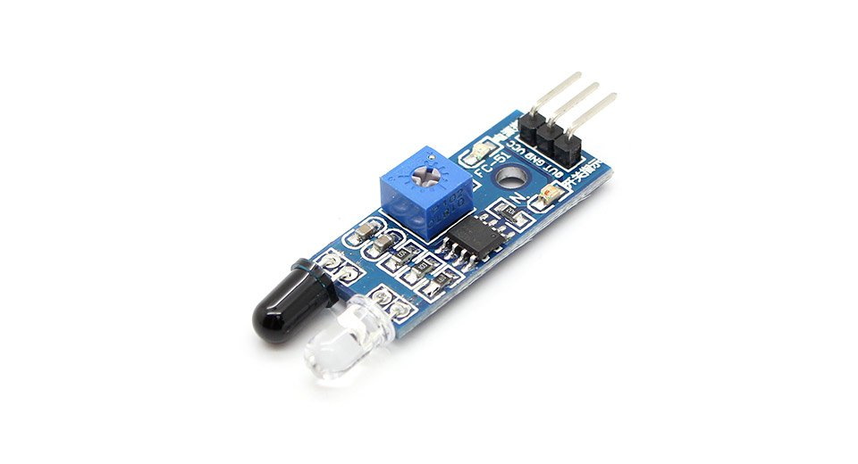
IR sensor
Range :2-10cm(variable)
Input supply voltage :5v
Sensing range :min:1cm max:15cm
Compatible device :arduino,VAR,8051,PIC,
ARM, microcontroller.

Slide 13
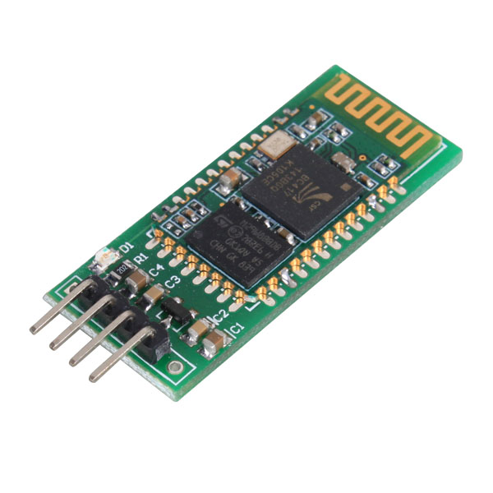
BLUETOOTH MODULE(HC-05)
Sensitivity:80 dBs
RF transmit power:+4 dBs
Power supply:1.8v to 3.6v
Speed : 2.1MBps

Slide 14
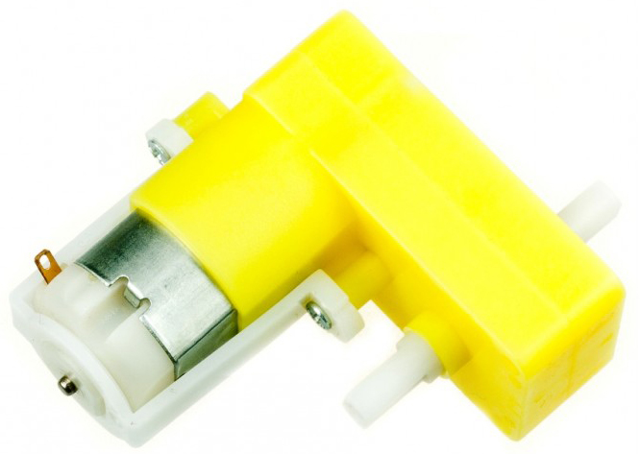
DC MOTOR
Operating range :3v to 12volts
Nominal voltage :12v
No load speed :5000 rpm
No load current :0.022A
Max efficiency speed :4906 rpm
Max torque :21.1 g.cm
Weight :50 gram
Operating temp : -10⁰c to 60⁰c

Slide 15
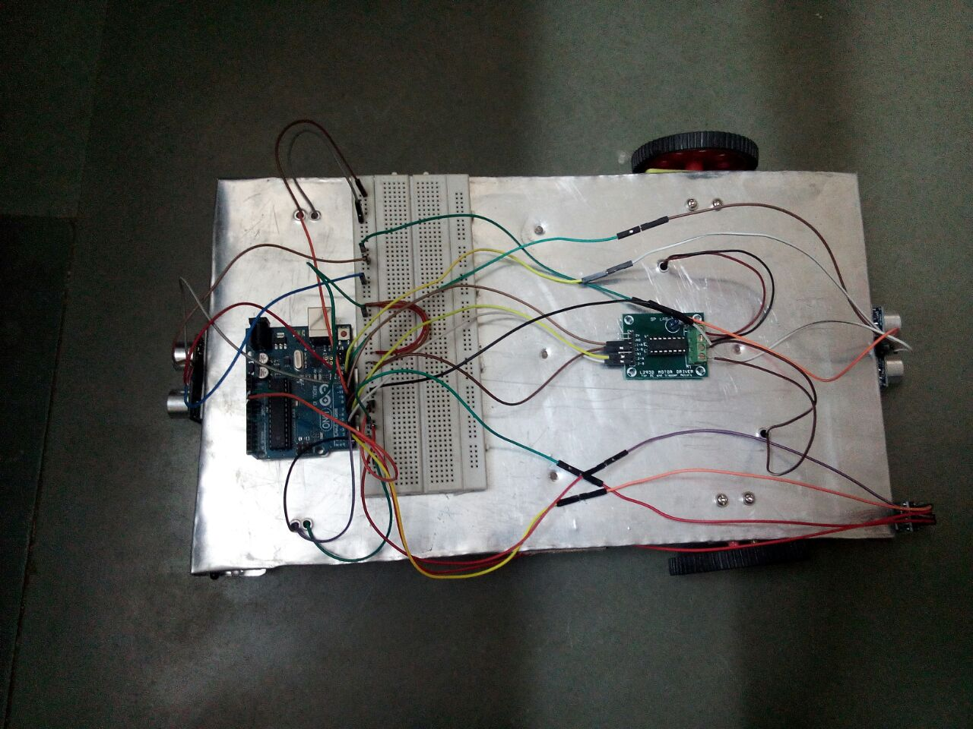
INITIAL PROTOTYPE

Slide 16
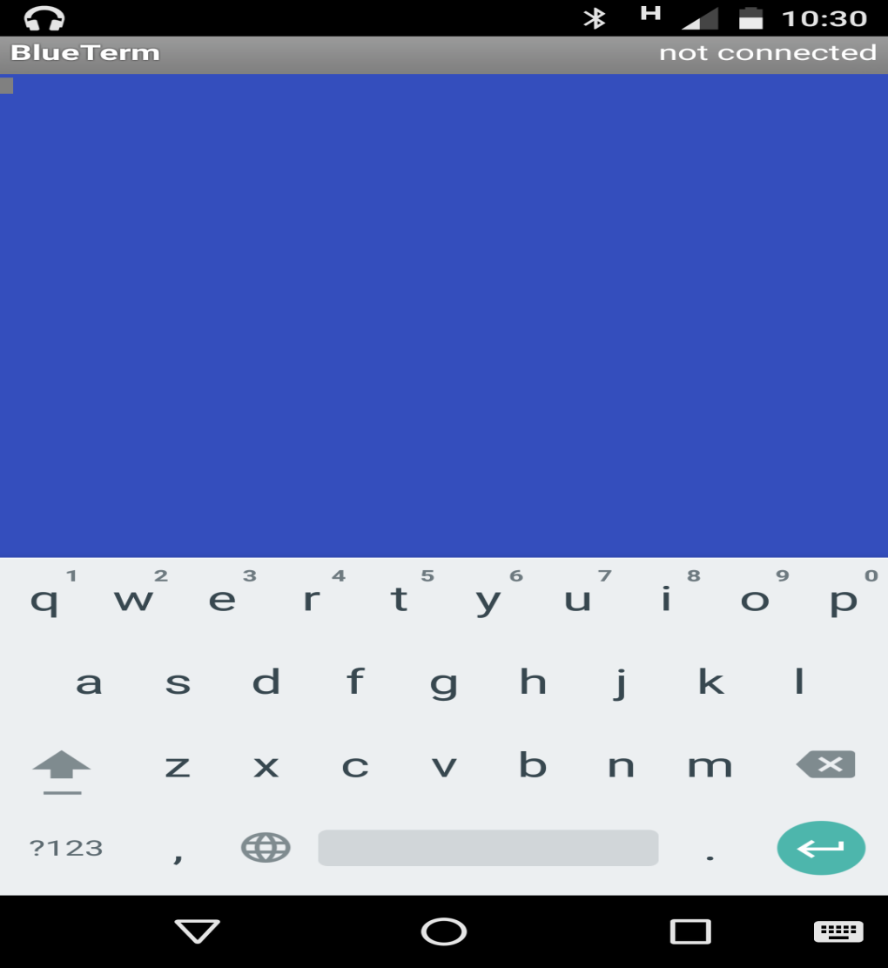

MOBILE CONTROL OPERATION

Slide 17
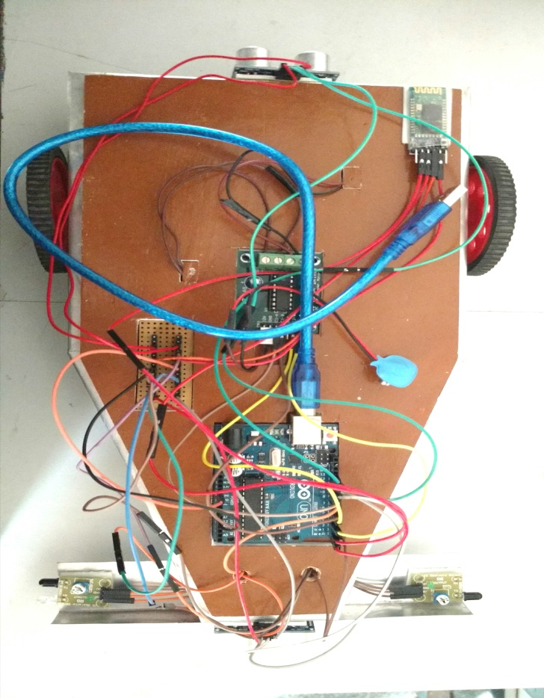
FINAL OUTLOOK

Slide 18
WORKING VIDEO

Slide 19
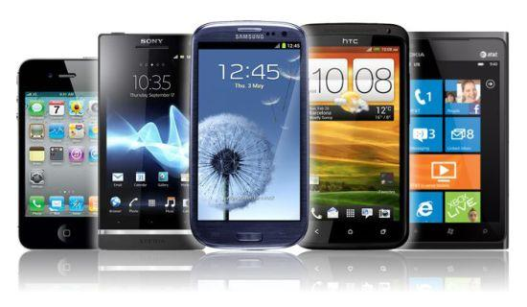
THANK YOU!

